Slide 1
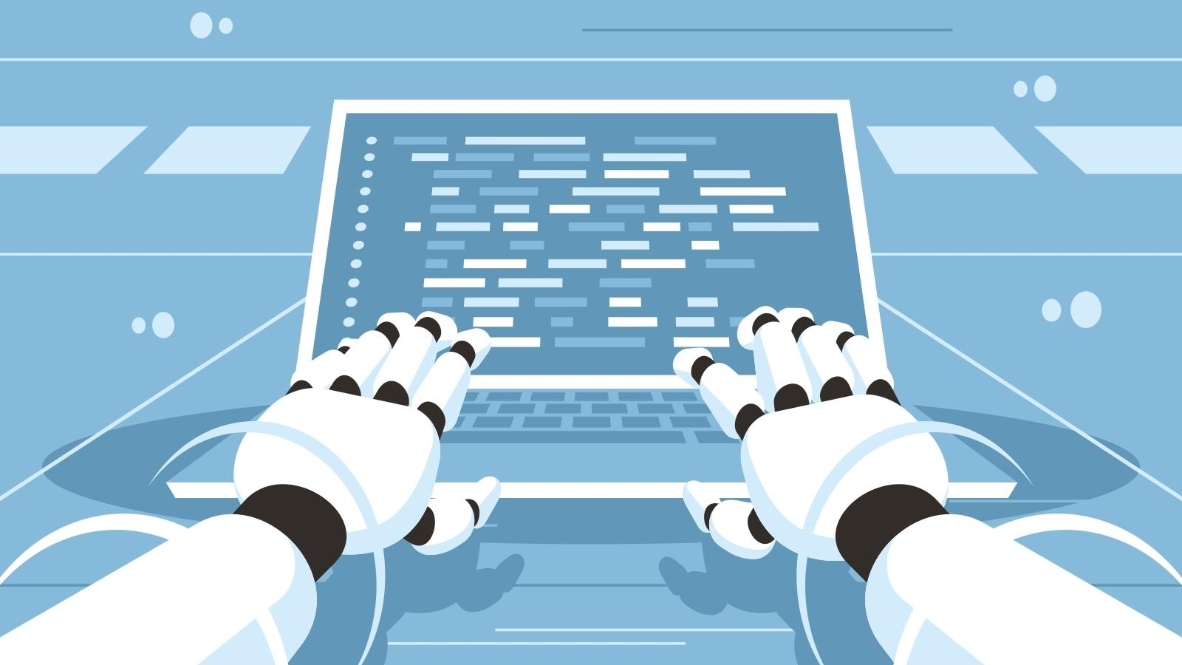
Exploration of Computer Science Jobs in the U.S
GROUP 8: ABDULLAH “AB” IBRAHIM, AL WAGNER, EDILBERTO “DEL” VINAS, JAY HOWARTH, CRYSTAL WHITE

Slide 2
EXECUTIVE SUMMARY
How We Approached the Project
How We Approached the Data Sourcing, Manipulation & Analysis
What We Learned
Results & Conclusions
Remaining Questions for Future Exploration
Appendix

Slide 3

HOW WE APPROACHED THE PROJECT
Notes:
Breakdown of our approach

Slide 4
READY, FIRE, AIM
Project review
Discussion of data sources & decision on BLS
Project timeline & outline
Tutoring session & initial pull of BLS data
Deeper data review & pivots
Illustrative examples of story we could tell (initial presentation creation)
Selection of specific types of data
Coding, testing, GitHub load, rinse, wash, repeat
Documentation (ReadMe)
Tutoring session (2) + Kadoa Co-founder discussion
Final analysis & presentation refinement

Slide 5

HOW WE APPROACHED THE DATA SOURCING, MANIPULATION & ANALYSIS
Notes:
Breakdown of our approach

Slide 6
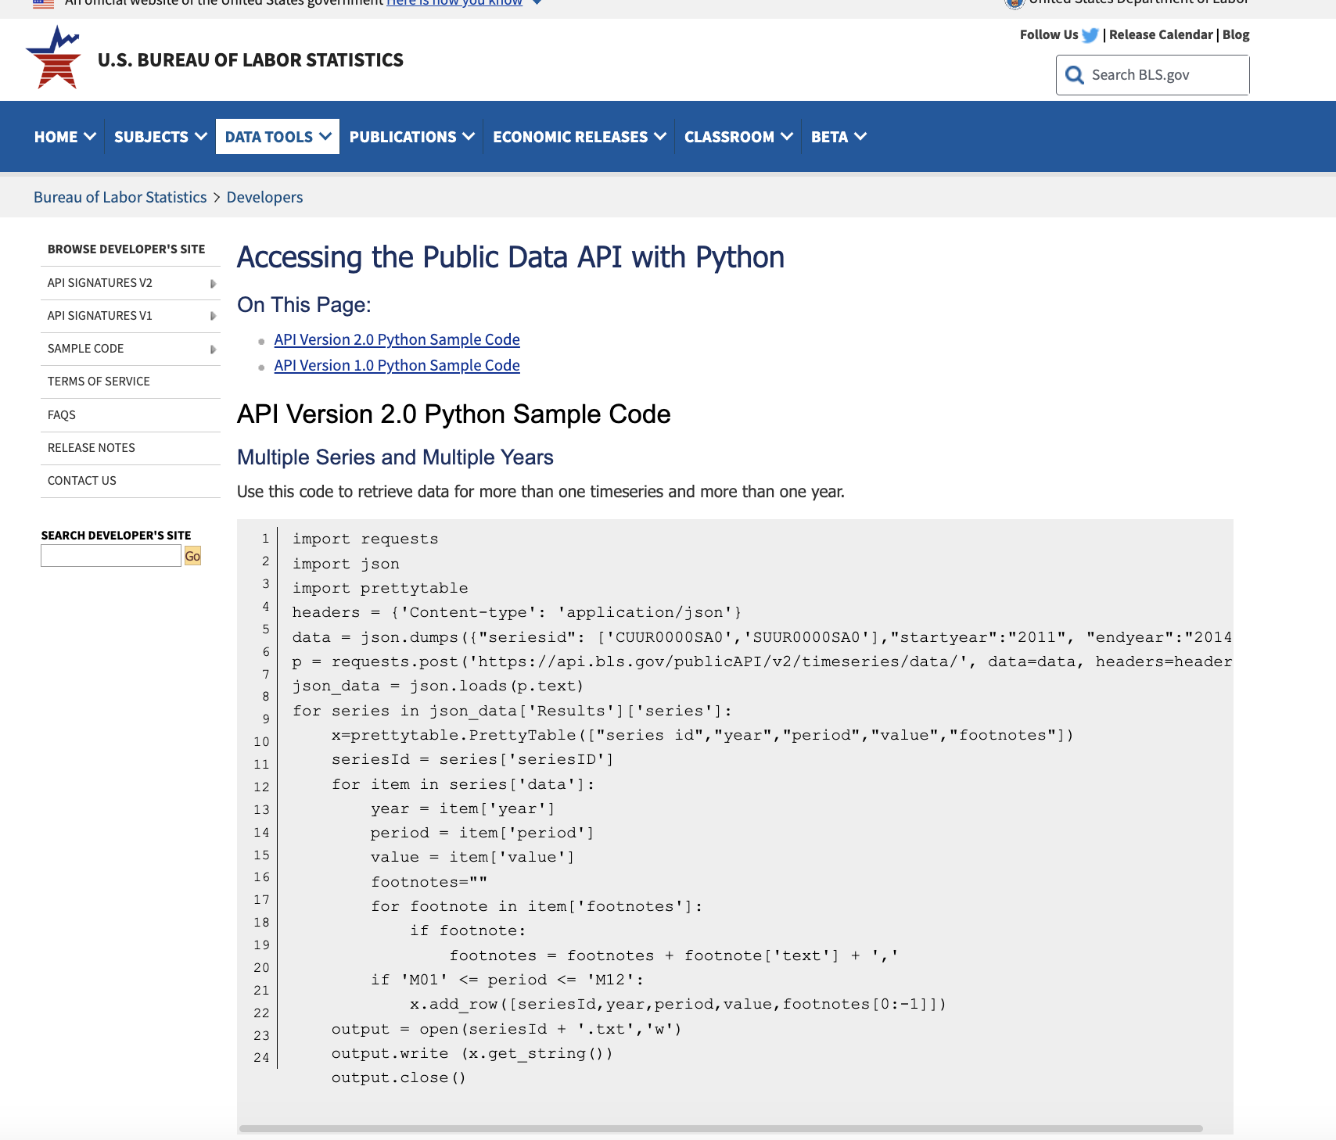
GETTING OUR HANDS ON SOME, BUT NOT TOO, MUCH DATA
The Approach
URLs for initial analysis: https://www.bls.gov/help/hlpforma.htm
API access: https://www.bls.gov/developers/api_python.htm
Breaking down code, data merges & manipulation, data visualization
Pivot: Computer science roles for multiple NAICS + Job data for AI-related roles
Supplementary information (BLS, White House report, tutoring sessions, Kadoa Co-founder discussion)
Kadoa

Slide 7
Code Snippet Overview
Imports the required libraries, including Prophet, and matplotlib for plotting.
Renames columns in the DataFrame to match Prophet's expected format.
Prepares the data for modeling.
Creates a Prophet model and adds seasonality.
Fits the model to the data.
Generates a future Datarame for forecasting.
Makes a forecast using the trained model.
Visualizes the forecast and its components using matplotlib.

Slide 8
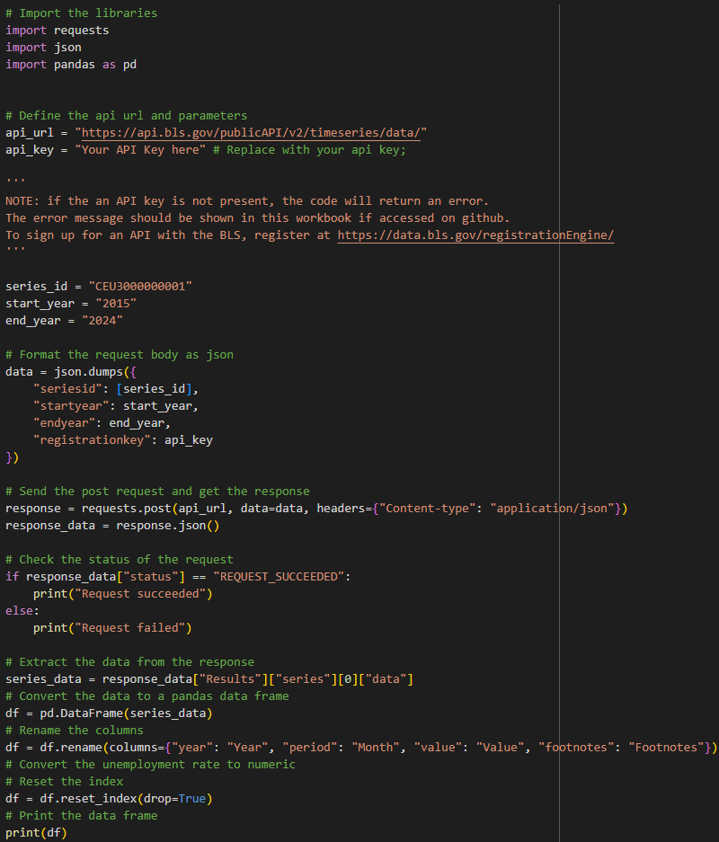
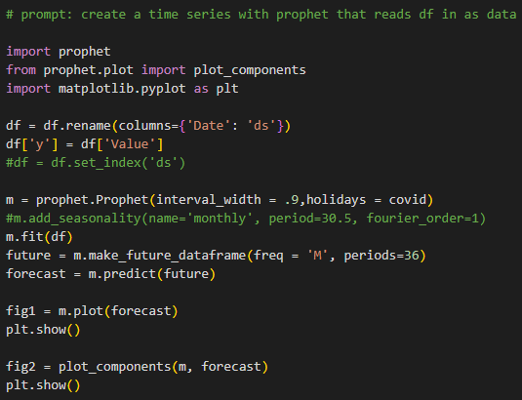
Code Snippet screenshots

Slide 9

Industry Employment Forecast
Notes:
Breakdown of our approach

Slide 10
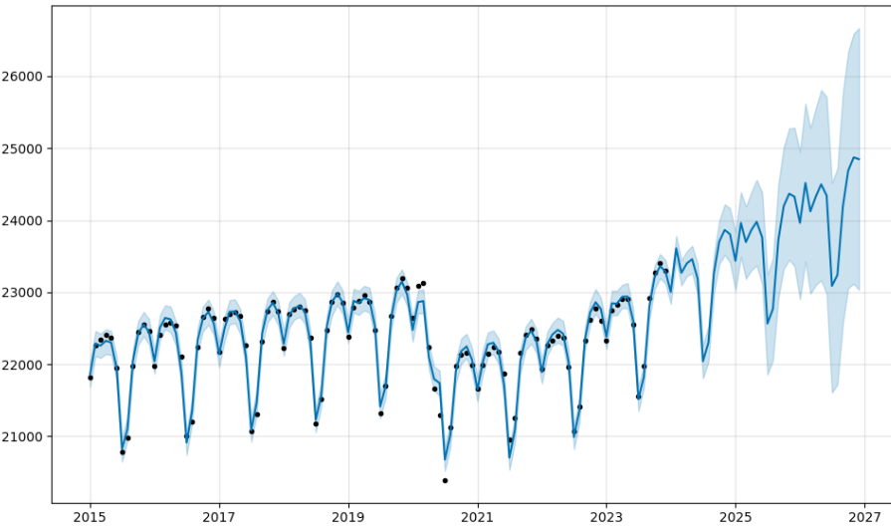
Government Employment Forecast
Analysis Highlights
Full-time employment in the government industry was trending slightly upwards until 2020 when COVID hit
Dropping to its lowest number of full-time employees since before 2015
Has not yet returned to pre-COVID levels
Employment
Year
Notes:
Computer and mathematical occupations (15%) & $100k median annual wage
Healthcare occupations (15%) & $30k median annual wage

Slide 11
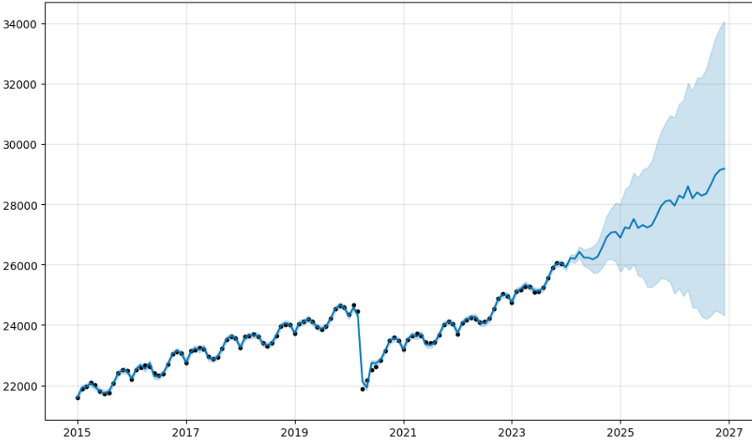
Health and Education Employment Forecast
Analysis Highlights
Overall employment was trending upwards until 2020
Job loss was not as significant as it was in the government industry, and it recovered much faster, reaching pre-pandemic levels by early 2023
Employment
Year
Notes:
Computer and mathematical occupations (15%) & $100k median annual wage
Healthcare occupations (15%) & $30k median annual wage

Slide 12
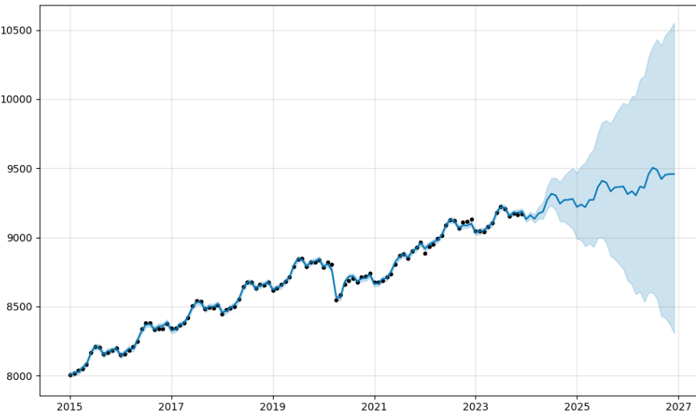
Financial Activities Employment Forecast
Analysis Highlights
We see significantly fewer jobs overall than in Government and Health and Education sectors;
Employment trends are similar to the other industries in that employment was trending upwards, dipped in 2020 (with a loss of less than 500,000) jobs
Reaching and exceeding pre-pandemic levels in 2021
Employment
Year
Notes:
Computer and mathematical occupations (15%) & $100k median annual wage
Healthcare occupations (15%) & $30k median annual wage

Slide 13
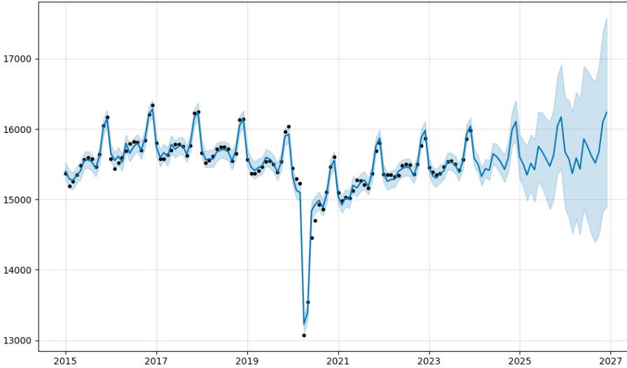
Retail Trade Employment Forecast
Analysis Highlights
Employs fewer full-time workers than either the Government or Healthcare and Education industries
More people are employed than within the Financial industry
Retail employment was declining before 2020 and may not yet reach 2019 employment levels until this year
Employment
Year
Notes:
Computer and mathematical occupations (15%) & $100k median annual wage
Healthcare occupations (15%) & $30k median annual wage

Slide 14
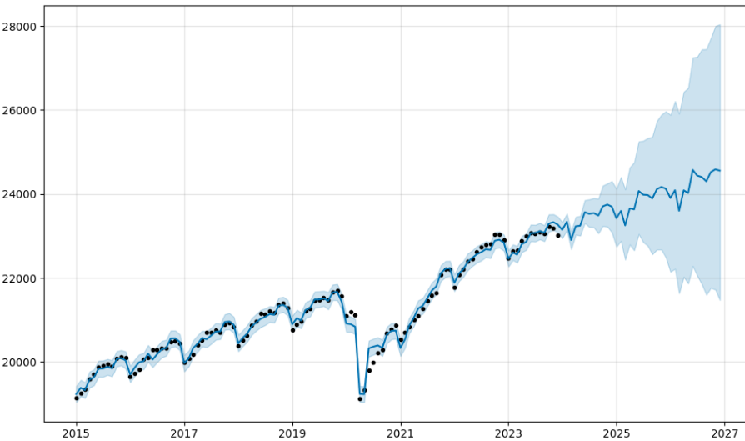
Professional and Business Services Employment Forecast
Analysis Highlights
With Professional and Business Services, we see similar overall employment numbers to Government and Health and Education
We also see a swift post-pandemic recovery period similar to the Financial industry
Reaching pre-pandemic employment levels mid-2021
Employment
Year
Notes:
Computer and mathematical occupations (15%) & $100k median annual wage
Healthcare occupations (15%) & $30k median annual wage

Slide 15
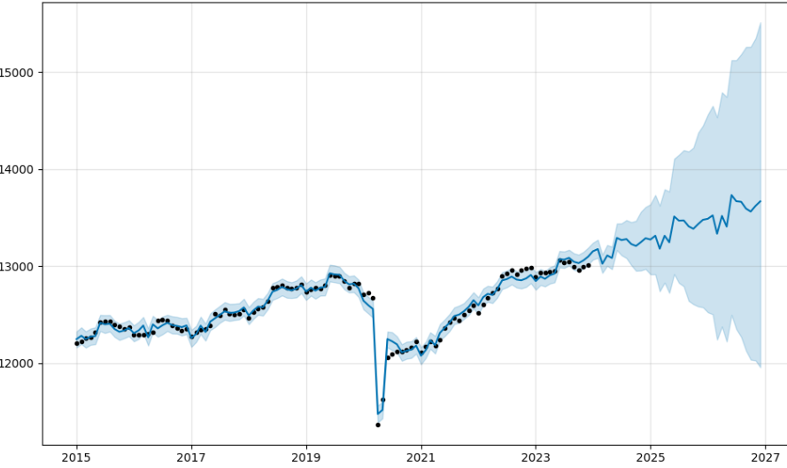
Manufacturing Employment Forecast
Analysis Highlights
At a peak of 13,000,000 full-time employees in 2019, manufacturing employs the 2nd lowest number of FTEs from the industries we’ve reviewed
Unlike Financial Services, Manufacturing didn’t reach pre-pandemic employment levels until 2023
Expected to increase by less than 1,000,000 jobs by 2027
Employment
Year
Notes:
Computer and mathematical occupations (15%) & $100k median annual wage
Healthcare occupations (15%) & $30k median annual wage

Slide 16

WHAT WE LEARNED
This Photo by Unknown Author is licensed under CC BY-SA-NC
Notes:
Breakdown of our approach

Slide 17
RESULTS & CONCLUSIONS
Access BLS data via API and how to use Prophet to analyze time-series data
Computer science is one of the top 2 growing occupations
Computer scientists have a median income at 2-3x the other similarly fast-growing occupation
Healthcare and Education and Business and Professional Services industries employ the most people
Now is the best time to be in AI

Slide 18

FUTURE RESEARCH
Notes:
Breakdown of our approach

Slide 19
AREAS TO EXPLORE WITH FUTURE RESEARCH
What are the most desirable skillsets (for programmers and non-programmers) within the field of artificial intelligence for the next 2-5 years?
Where are the best places to live and work in for artificial intelligence jobs, if remote work isn’t an option?
Will Kadoa be a good source for our classmates to review new job postings and ultimately secure a new role in artificial intelligence?
How might we connect with government agencies who are seeking to build a new civilian workforce, as recommended by the NSCAI?

Slide 20
Appendix
SUPPLEMENTARY READING AND RESOURCES
Bureau of Labor Statistics. (2023, December 5). 10 major occupational groups with higher-than-average wages projected to grow faster than average. Retrieved from https://www.bls.gov/opub/ted/2023/10-major-occupational-groups-with-higher-than-average-wages-are-projected-to-grow-faster-than-average.htm
Bureau of Labor Statistics. (2023). Data extracted from the Bureau of Labor Statistics API. Retrieved from https://www.bls.gov/developers/api_python.htm
Council of Economic Advisors. (2022, December 5). The impact of artificial intelligence on the future of workforces in the European Union and the United States of America. Retrieved from https://www.whitehouse.gov/wp-content/uploads/2022/12/TTC-EC-CEA-AI-Report-12052022-1.pdf
LinkedIn. (n.d.). Job listings for 'artificial intelligence'. Retrieved 2023, January 8, from https://www.linkedin.jobs.com
The National Security Commission on Artificial Intelligence. (2021, October 5). 2021 Final Report. Retrieved from https://cybercemetery.unt.edu/nscai/20211005220409/https://reports.nscai.gov/final-report/table-of-contents/
Smith, M. (2023, November 2). The most in-demand AI job of 2023 can pay over $200,000 and offers remote opportunities. CNBC.com. Retrieved from https://www.cnbc.com/2023/11/02/the-most-in-demand-ai-job-of-2023-can-pay-over-200000-and-offers-remote-opportunities.html

